Slide 1

So That’s What They’re Looking for…
Recent Life Safety Items
Presenter: John F. Kerney

Slide 2

Agenda
Review of recent K tag citations found during survey.
What can we do to reduce chance of it happening to us? Tips and tools to avoid most common citations

Slide 3
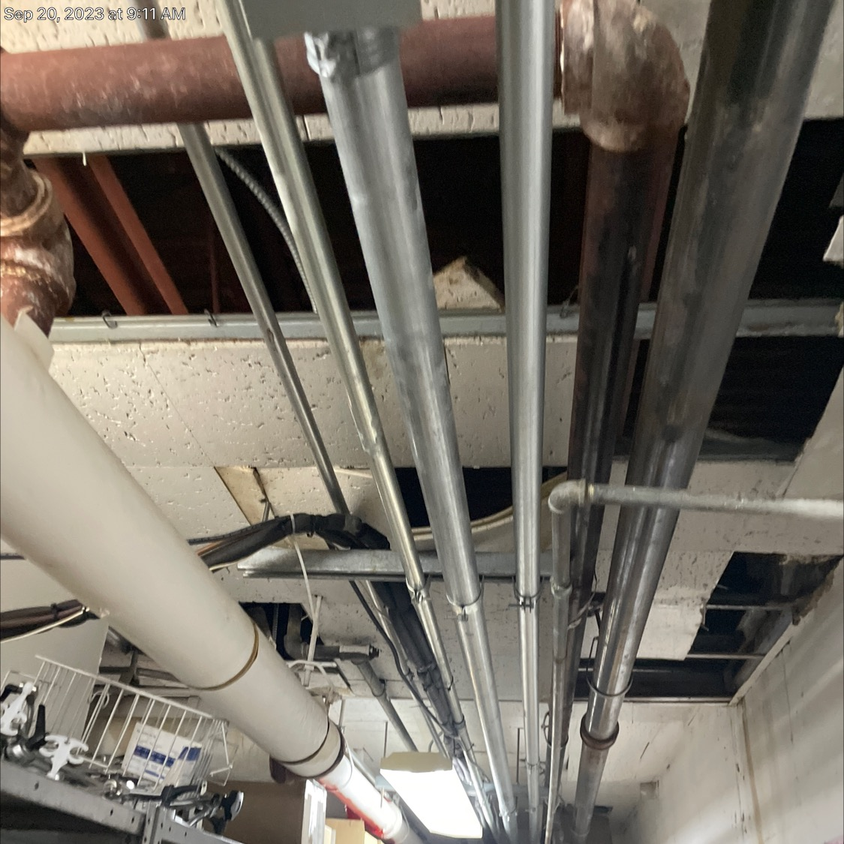
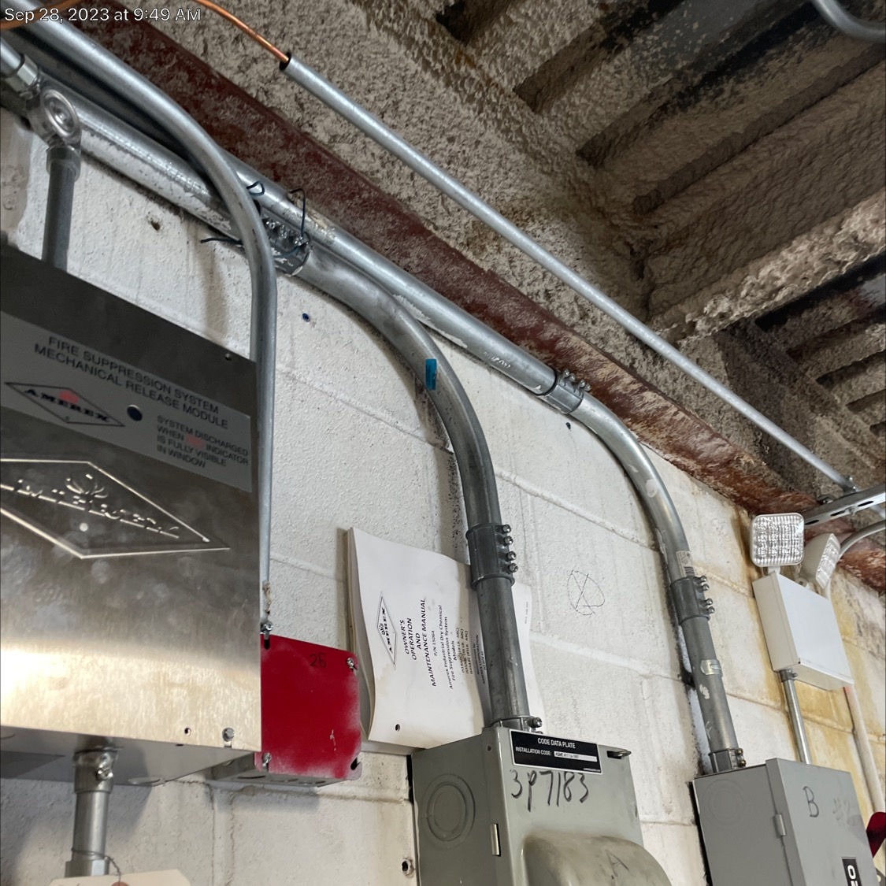
Recent K-Tag Citations During Survey
K161 Building Construction Type and Height
  2012 EXISTING
    Building construction type and stories meets Table 19.1.61, unless otherwise permitted by 19.1.6.2 through 19.1.6.7
Need to ensure that all steel work is covered and protected from fire. Occurs when improper renovation work has been performed or deterioration of existing material Inspect above ceiling that no steel is visible.

Slide 4
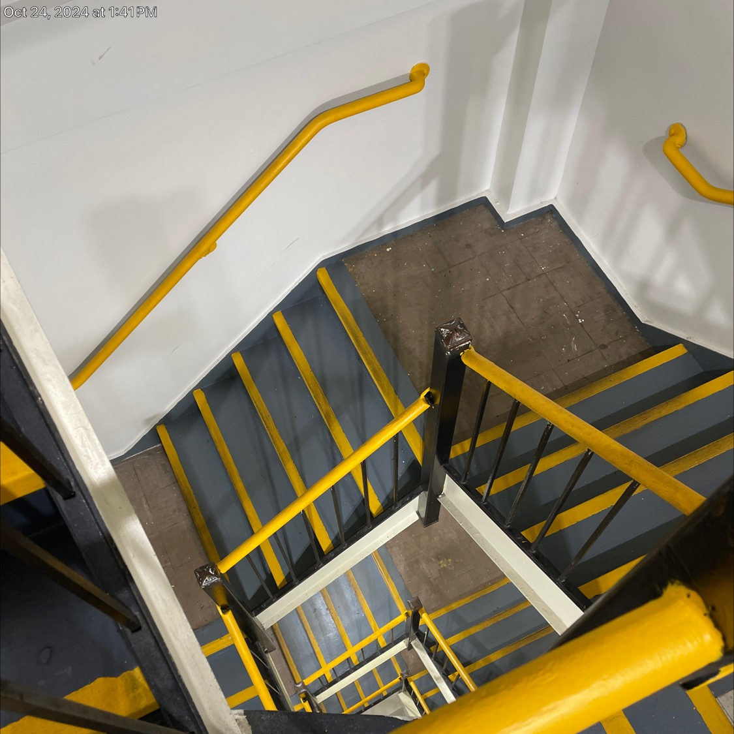
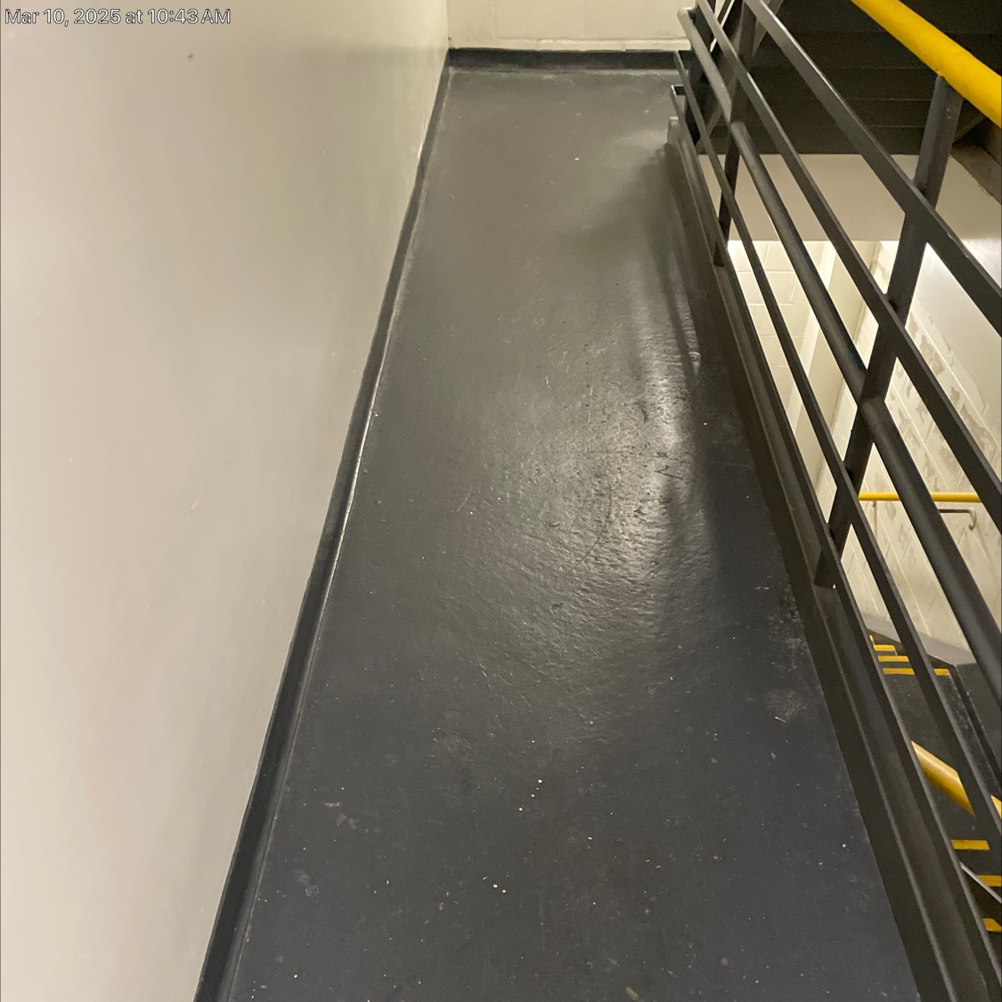
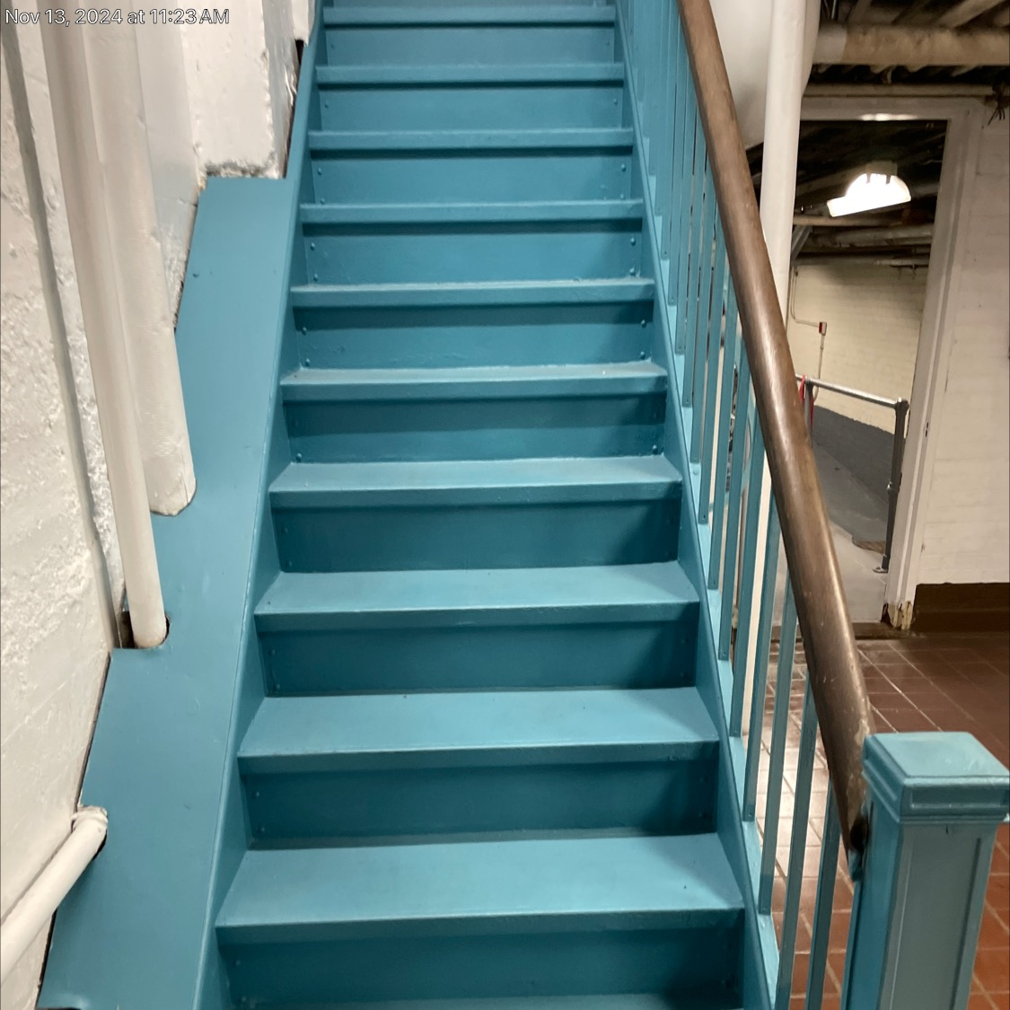
Recent K-Tag Citations During Survey
K200 Means of Egress Requirements – Other
  Stairwell marking as per NFPA 101 Chapter 7.5.5.5.1
Review the stairwell marking. The requirements in this section is more than just the steps. Handrails and all landings are also required to marked.

Slide 5
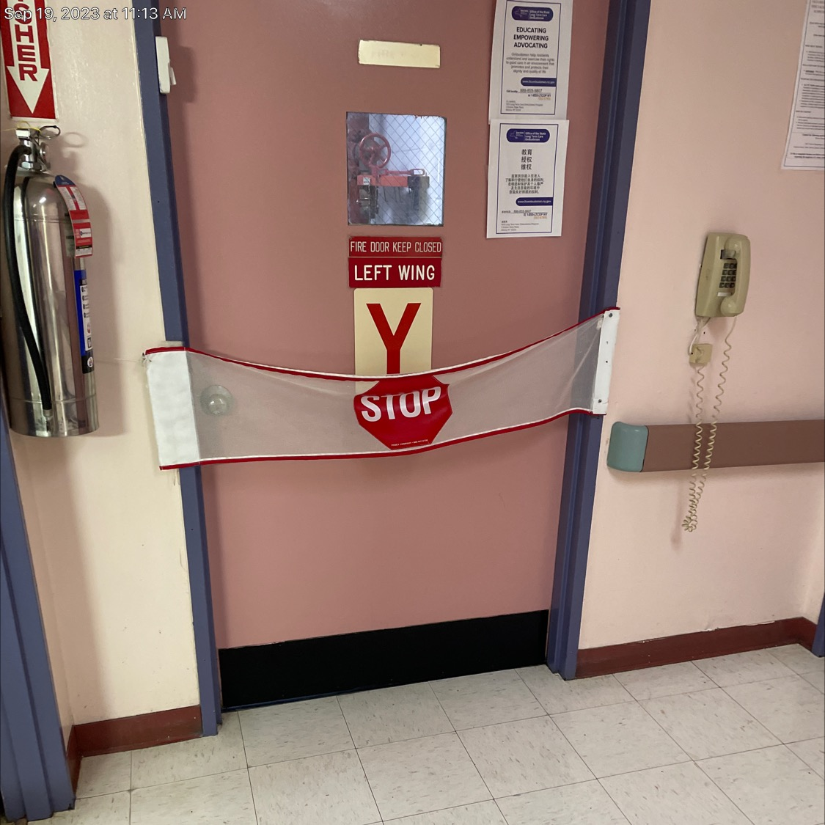
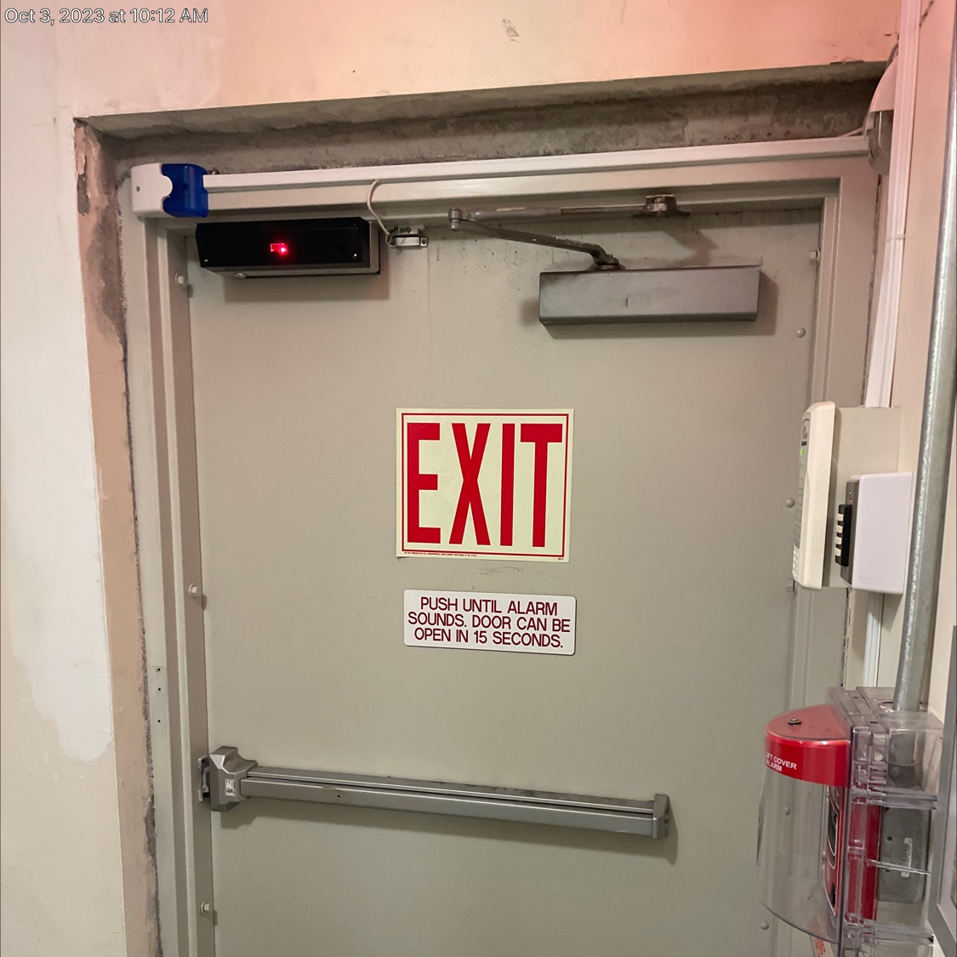
Recent K-Tag Citations During Survey
K222 Egress Doors
  Doors in a required means of egress shall not be equipped with a latch or a lock that requires the use of a tool or key from the egress side unless using one of the following special locking arrangements
This section includes the magnetic door locks utilized for elopement control. Be sure all staff know means to bypass and have log for inspection. Test the delayed function for time to release. Be sure proper signage is on doors.

Slide 6
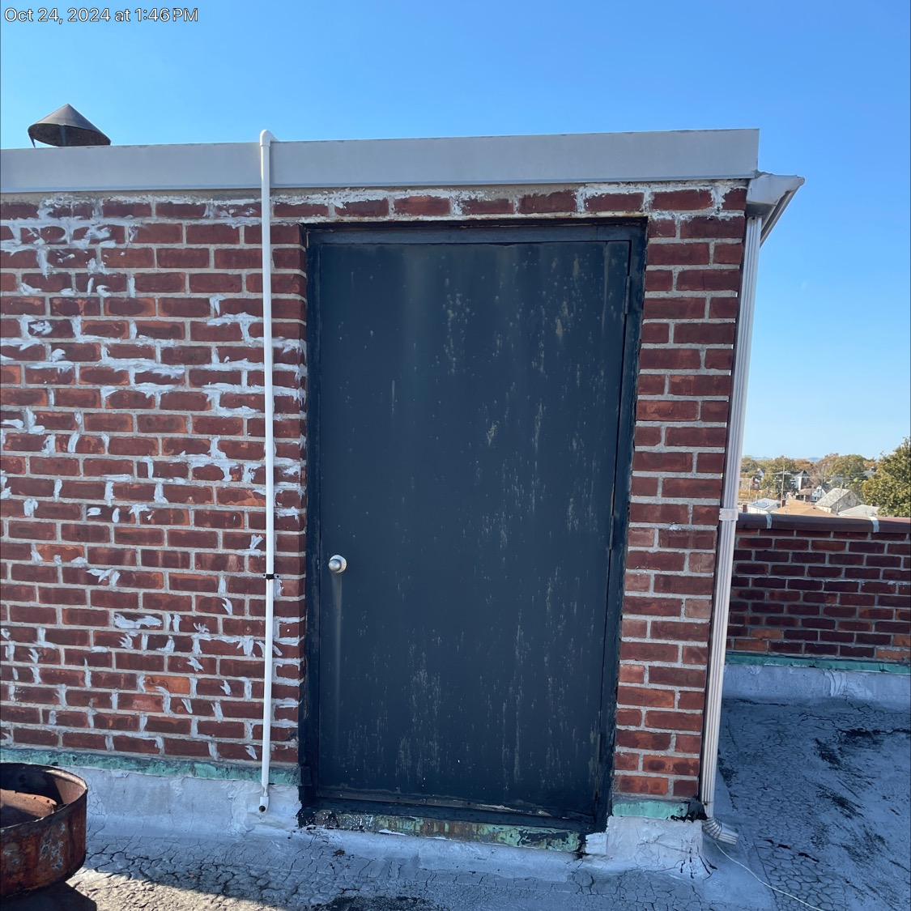
Recent K-Tag Citations During Survey
K281 Illumination of Means of Egress
  Illumination of means of egress, including exit discharge, is arranged in accordance with 7.8 and shall be either continuously in operation or capable of automatic operation without manual intervention.
Be sure all exterior lighting is functional. There should not be a mechanical timer controlling the lights. Occupancy or motion detectors may be utilized for energy savings. Photocells are also permitted

Slide 7

Areas of Fire Protection
K311 Vertical Openings – Enclosure
  Stairways, elevator shafts, light and ventilation shafts, chutes, and other vertical openings between floors are enclosed with construction having a fire resistance rating of at least 1-hour. An atrium may be used in accordance withNFPA101- 8.6,19.3.1.1 through 19.3.1.6
K321 Hazardous Areas – Enclosure
  Hazardous areas are protected by a fire barrier having 1-hour fire resistance rating (with ¾ hour fire rated doors) or an automatic fire extinguishing system in accordance with 8.7.1. When the approved automatic fire extinguishing system option is used, the areas shall be separated from other spaces by smoke resisting partitions and doors in accordance with 8.4. Doors shall be self-closing or automatic-closing and permitted to have nonrated or field-applied protective plates that do not exceed 48 inches from the bottom of the door.
These are the small holes we find when new cabling has been run for video and other items. Have in place a sign off for inspection after any work has been performed. This should include the fire stopping material utilized.
Fuel fired heater rooms, Laundries, Maintenance, trash collection over 64 gallons and combustible storage over 50 square feet. In these areas we are finding open penetrations, non closing/latching doors, missing ceiling systems/tiles.

Slide 8
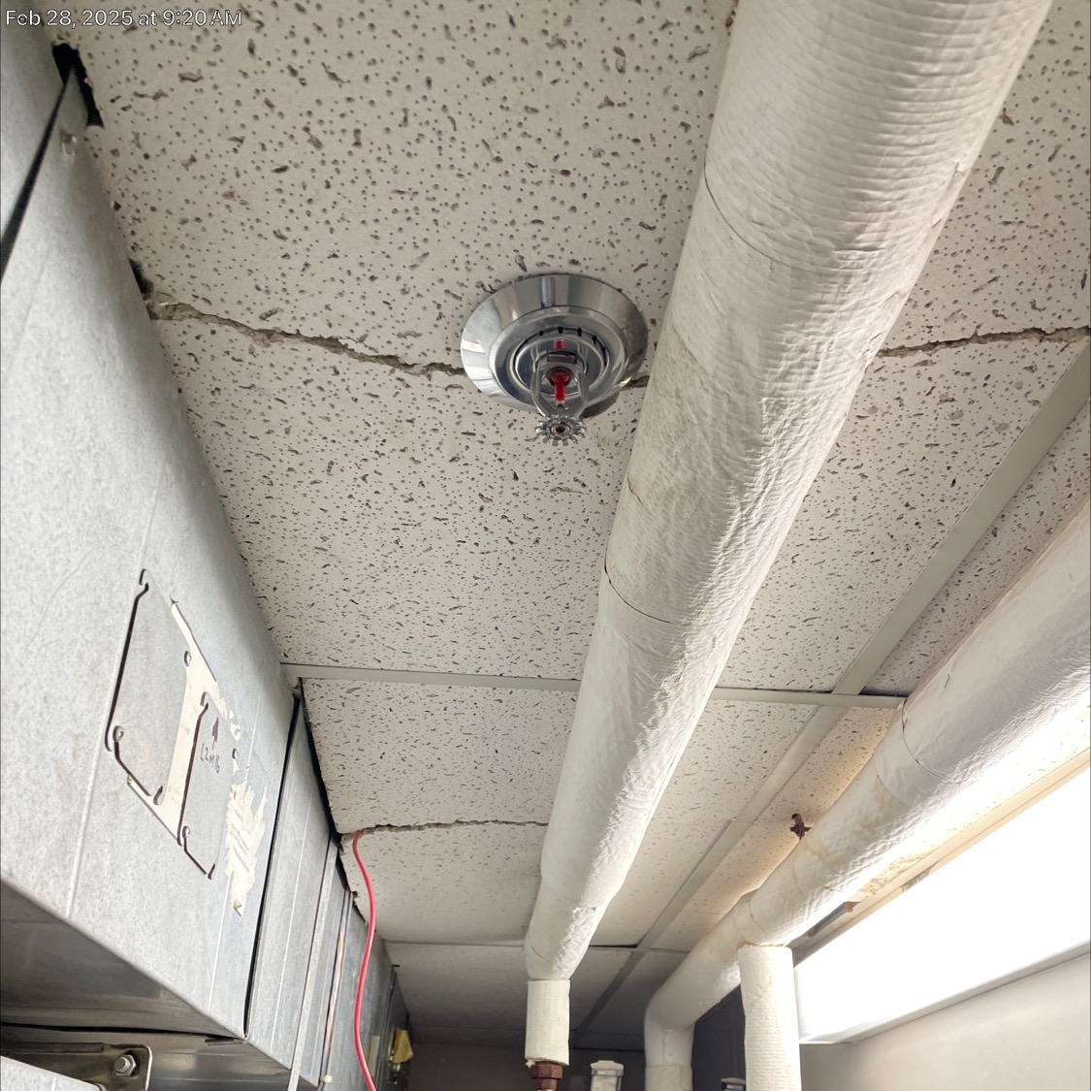
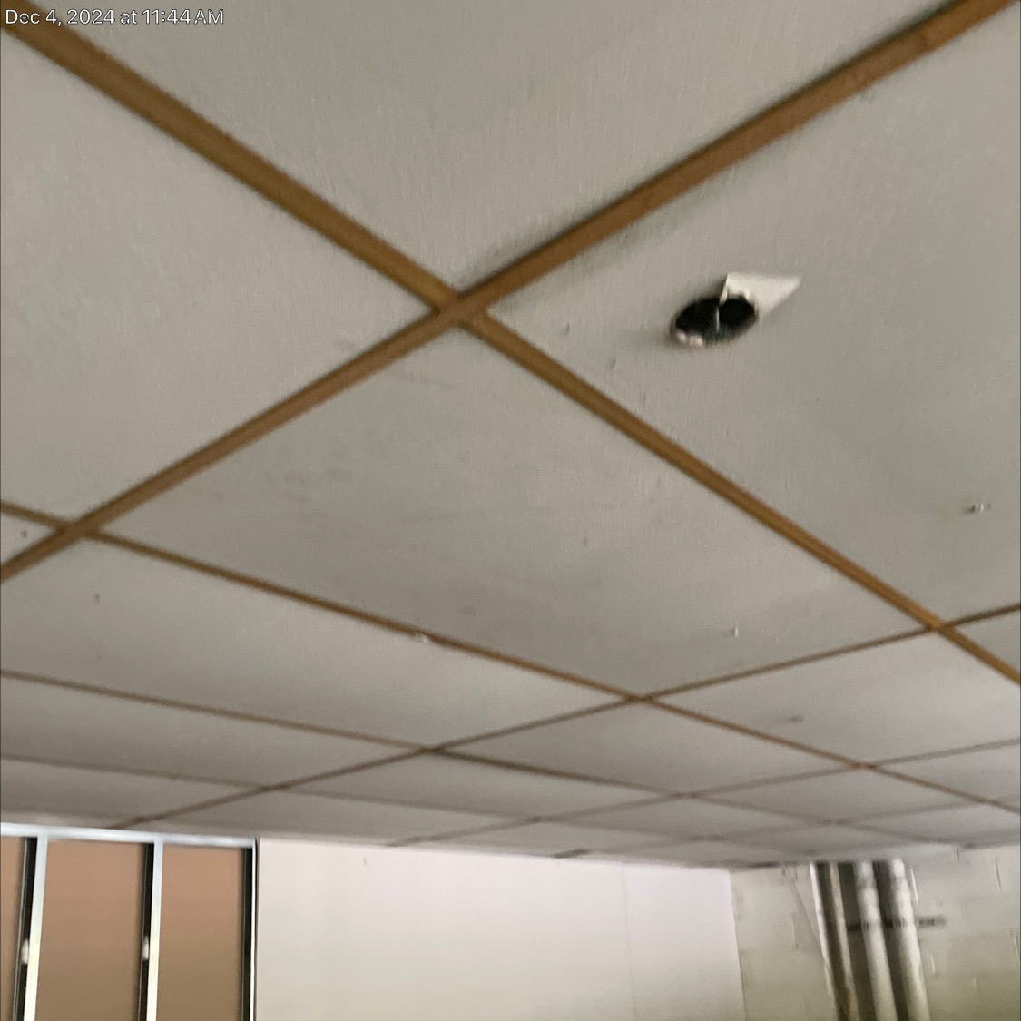
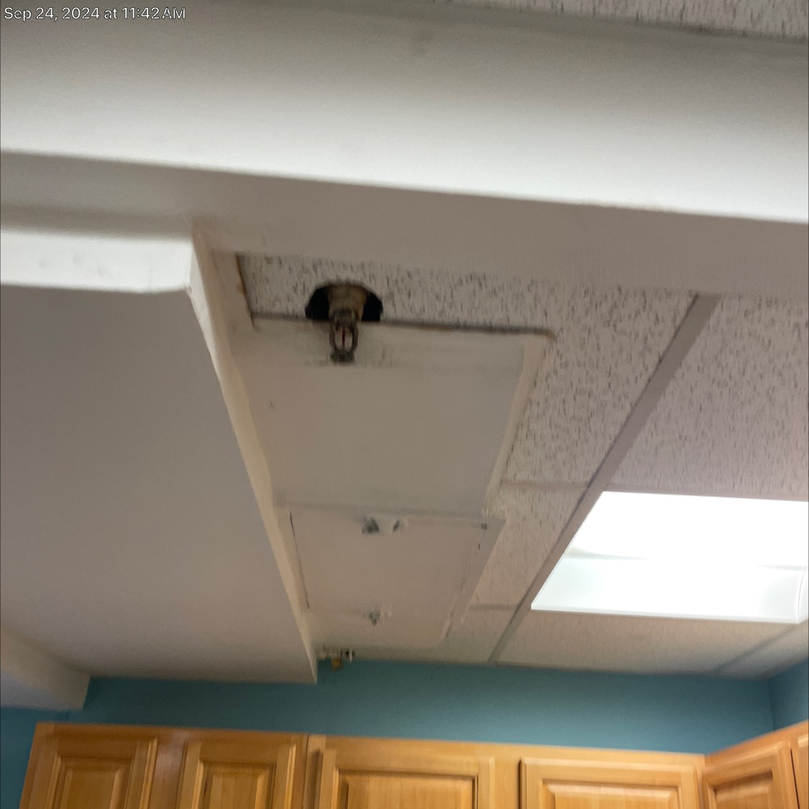
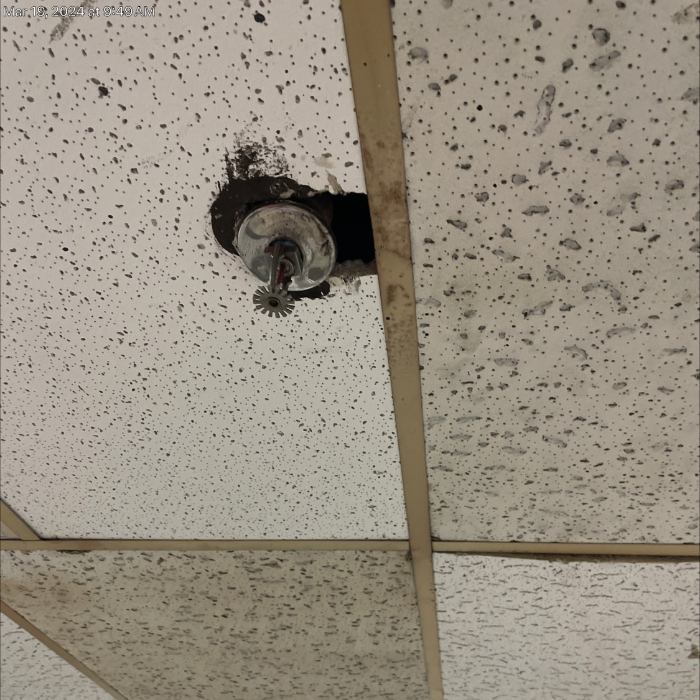
Areas of Fire Protection
K351 Sprinkler System – Installation
  Buildings are to be protected throughout by an approved automatic sprinkler system in accordance with NFPA 13, Standard for the Installation of Sprinkler Systems.
This is something which continues to be problematic. Spacing of heads, coverage in alcoves, mixed type of head, and insufficient spare heads continue be found. Need to have the Master fire suppression team conduct a review for all the above.

Slide 9
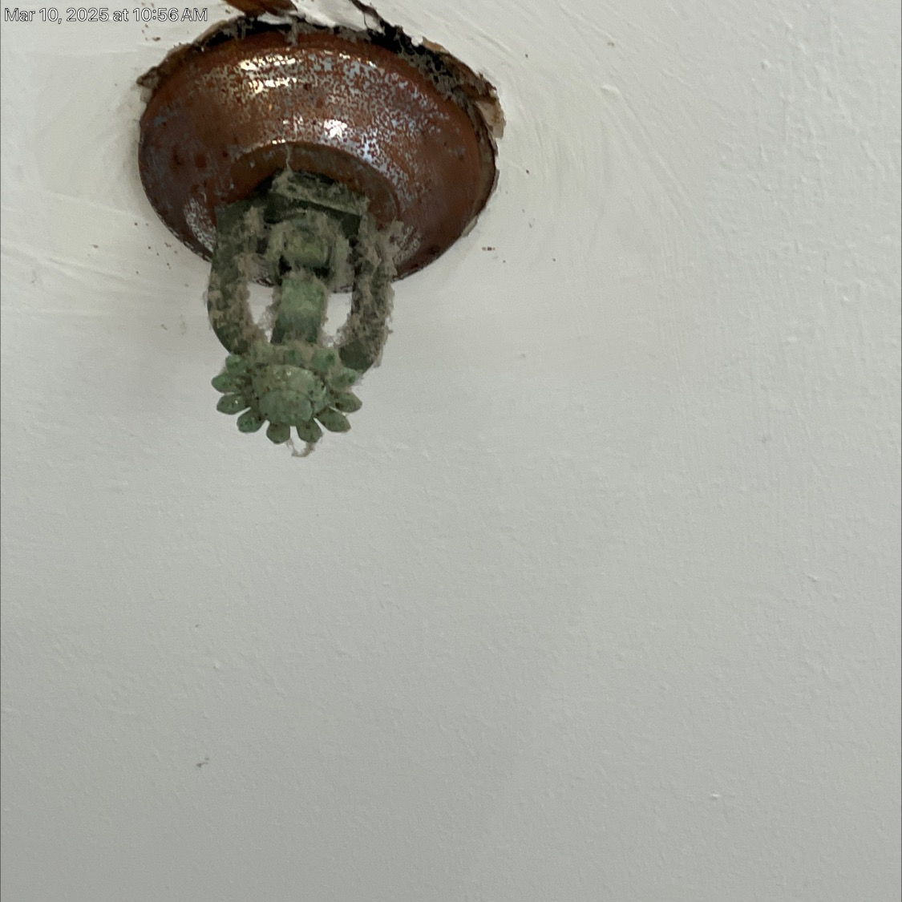
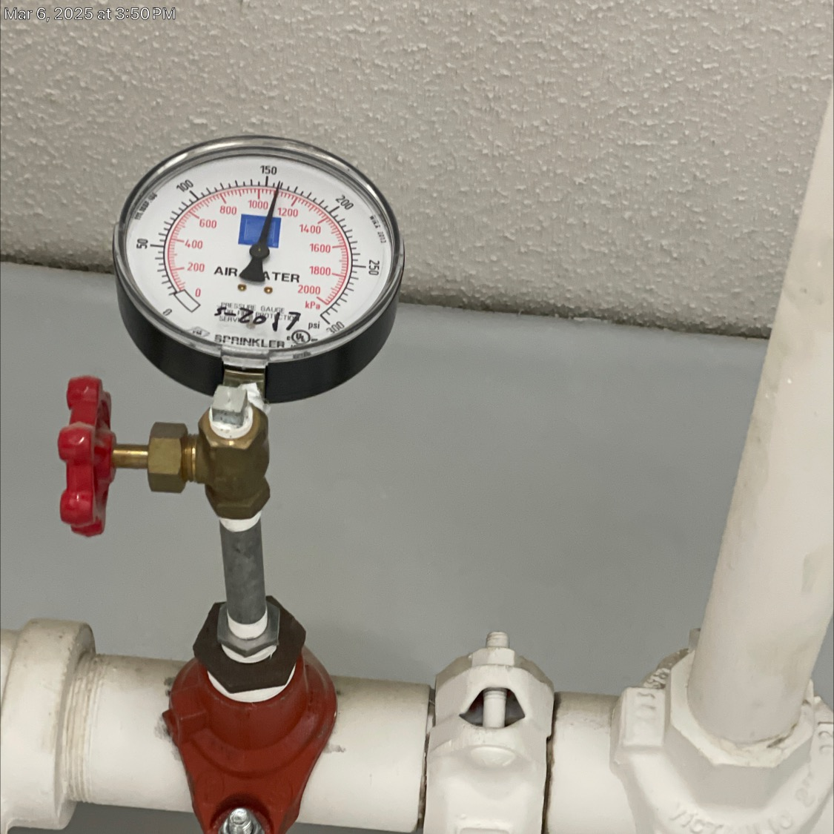
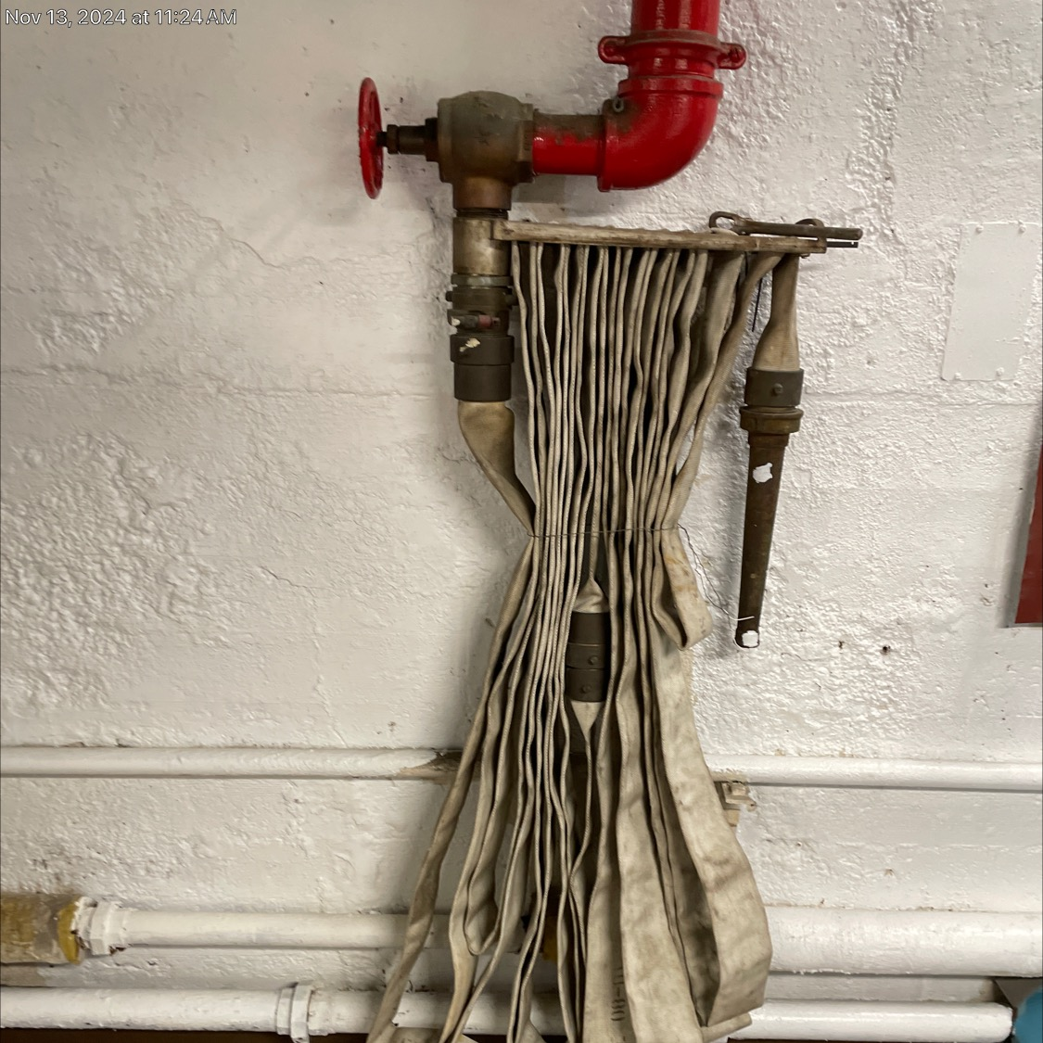
Areas of Fire Protection
K353 Sprinkler System – Maintenance and Testing
  Automatic sprinkler and standpipe systems are inspected, tested, and maintained in accordance with NFPA 25, Standard for the Inspection, Testing, and Maintaining of Water-based Fire Protection Systems. Records of system design, maintenance, inspection and testing are maintained in a secure location and readily available.
Ensure that all the sprinkler inspection documentation contains the requires for NFPA 25.
Additionally, be sure whenever work s performed on ceilings that escutcheon plates are reinstalled. Ceilings need to be sealed tight to prevent smoke from bypassing the heads so sprinklers will activate. Fire hoses are within date.

Slide 10
Areas of Fire Protection
Other concerns
  These items are cited in various tags
Doors opening onto exit corridors held open by door stops.
Missing the required four-year damper inspection reports.
Annual fire door inspections as per NFPA 80
Penetrations through fire walls.
Electrical conduits in stair towers.
Storage rooms opening directly into stairs.

Slide 11
Operating Features
K531 Elevators
  Elevators comply with the provision of 9.4. Elevators are inspected and tested as specified in ASME A17.1, Safety Code for Elevators and Escalators. Firefighter’s Service is operated monthly with a written record.
K521 Plenums
2012 NFPA 90A 4.3.11 Plenums
Yhe return air plenum when utilized above the ceilings requires the area to be fully sealed to prevent air infiltration to surrounding rooms. These systems are often used in corridors.
Ensure that facility is conducting and logging the recall of elevators.
If your ventilation system has a plenum the facility should conduct an above ceiling inspection to ensure that it meets these requirements.

Slide 12

HEALTH CARE FACILITIES
CODE REQUIREMENTS
K901 Fundamentals – Building System Categories
  Building systems are designed to meet Category 1 through 4 requirements as detailed in NFPA 99. Categories are determined by a formal and documented risk assessment procedure performed by qualified personnel. Chapter 4 (NFPA 99)
Complete the assessment form for your buildings systems. Can be found online search NFPA 99 assessment. Your care team should be involved with this review as it also aids in completing the required HVA for emergency management.

Slide 13
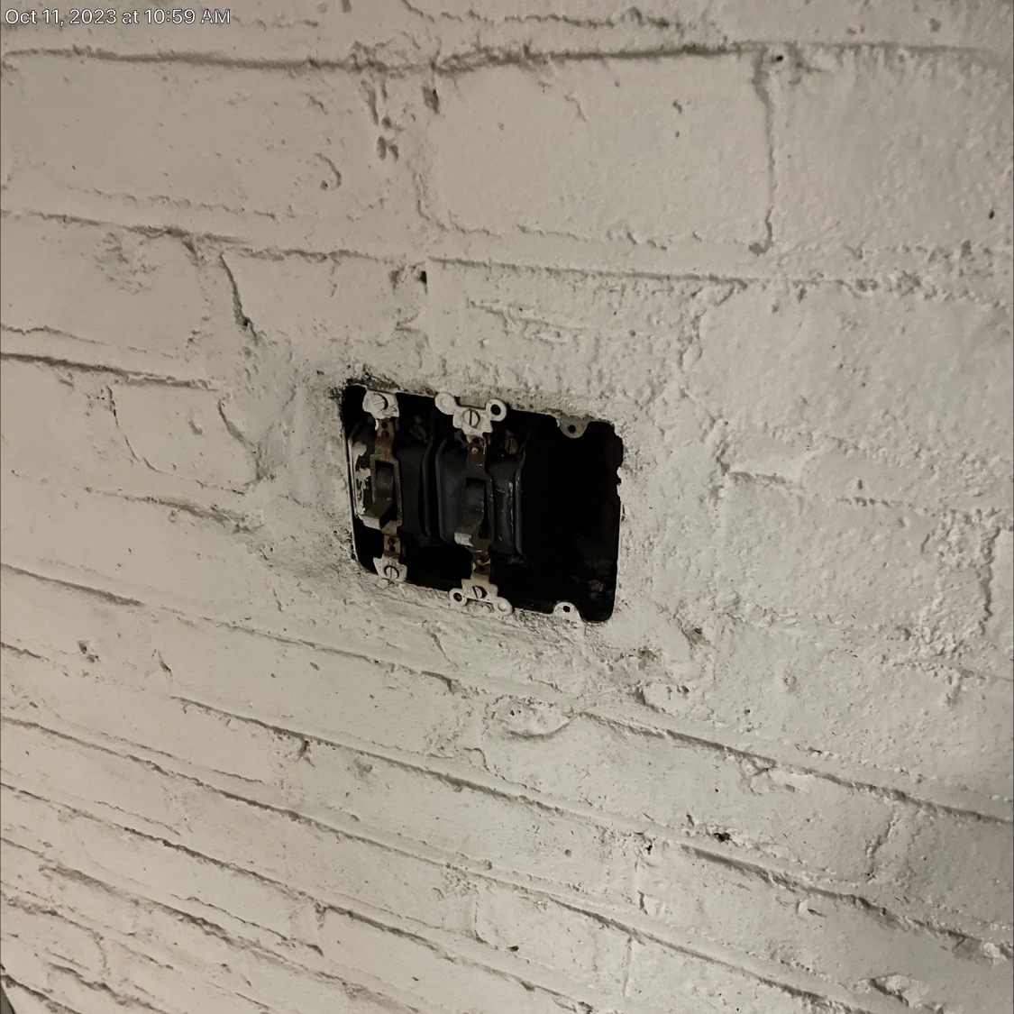
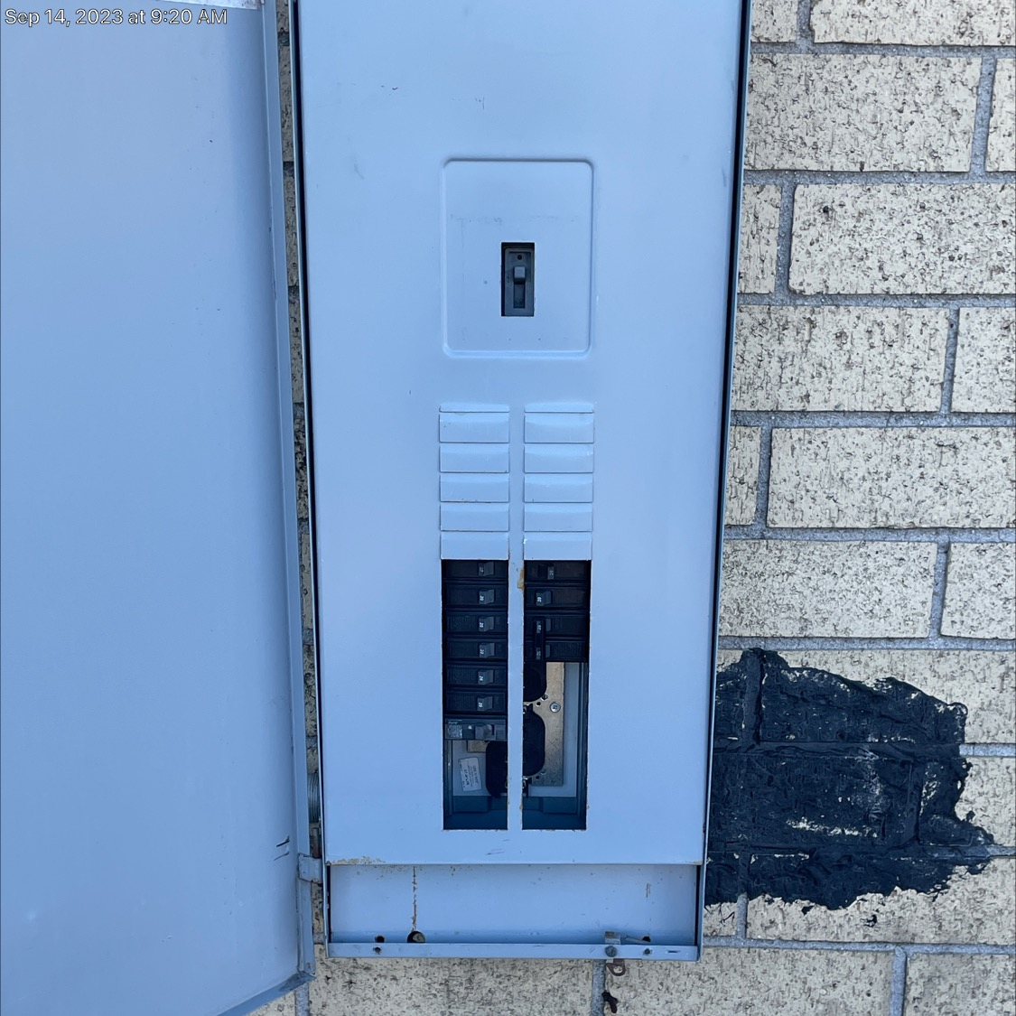
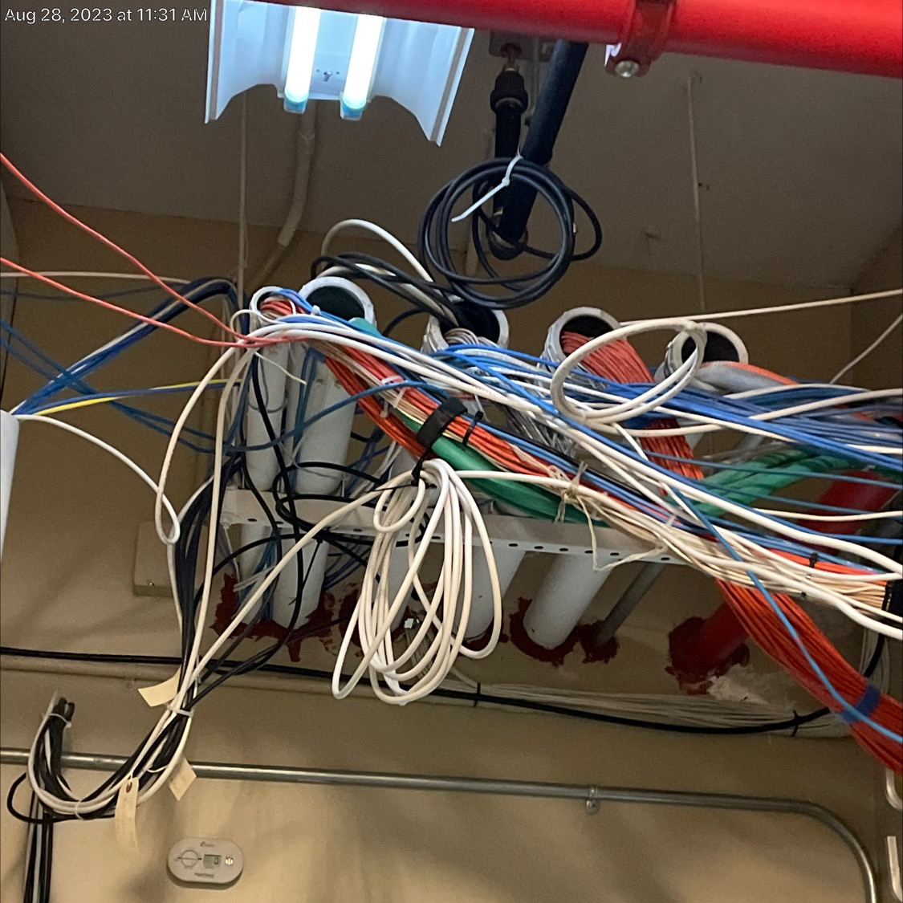
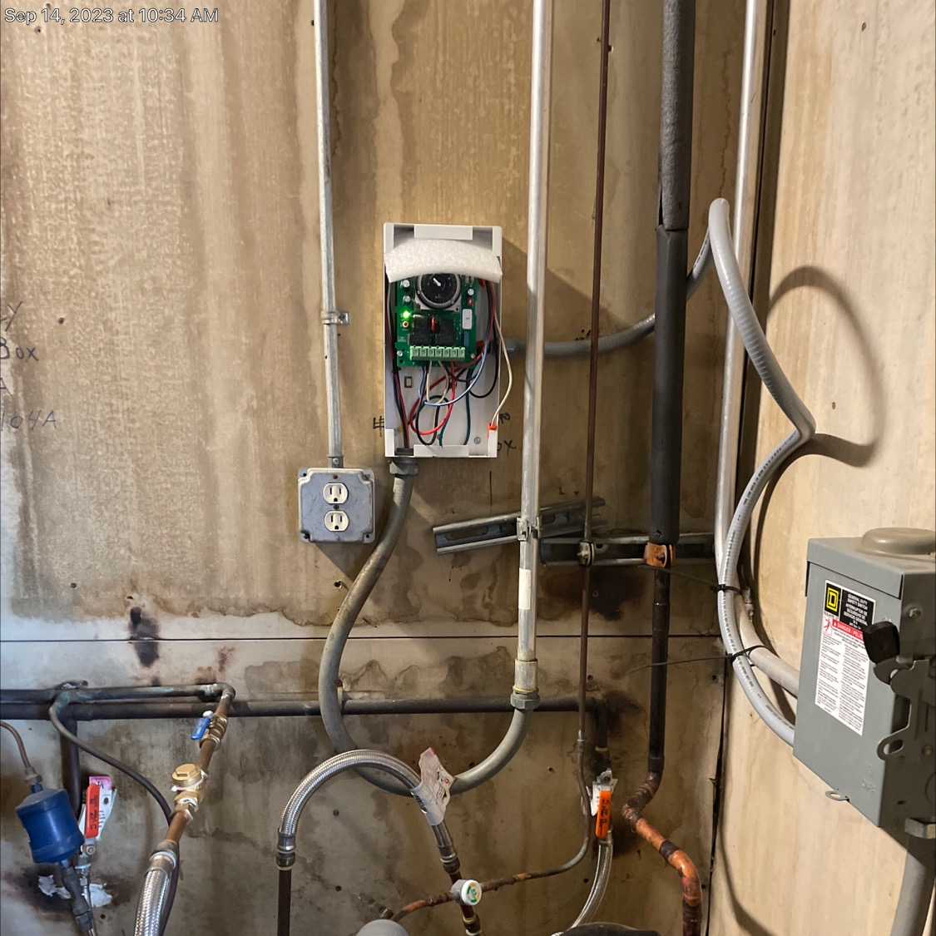
HEALTH CARE FACILITIES
CODE REQUIREMENTS
K911 Electrical Systems – Other
  Electrical Systems requirements that are not addressed by the provided K-Tags but are deficient. Chapter 6 (NFPA 99)
There are citations being written on this K tag as chapter requires compliance with NFPA 72 the electric code. What to look for are missing cover plates, wiring not enclosed in boxes, and unlabeled/missing circuit breakers.

Slide 14
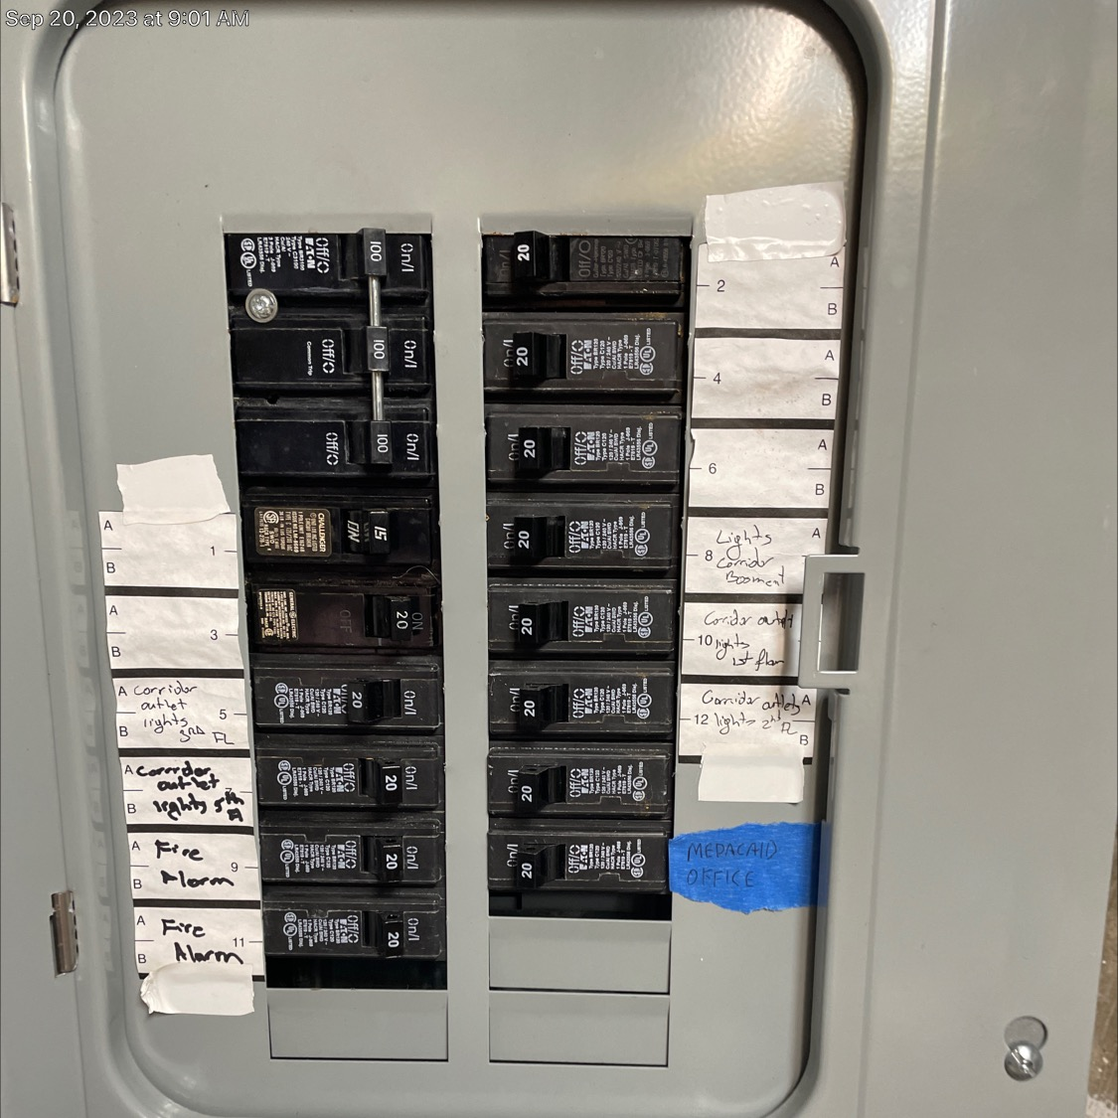
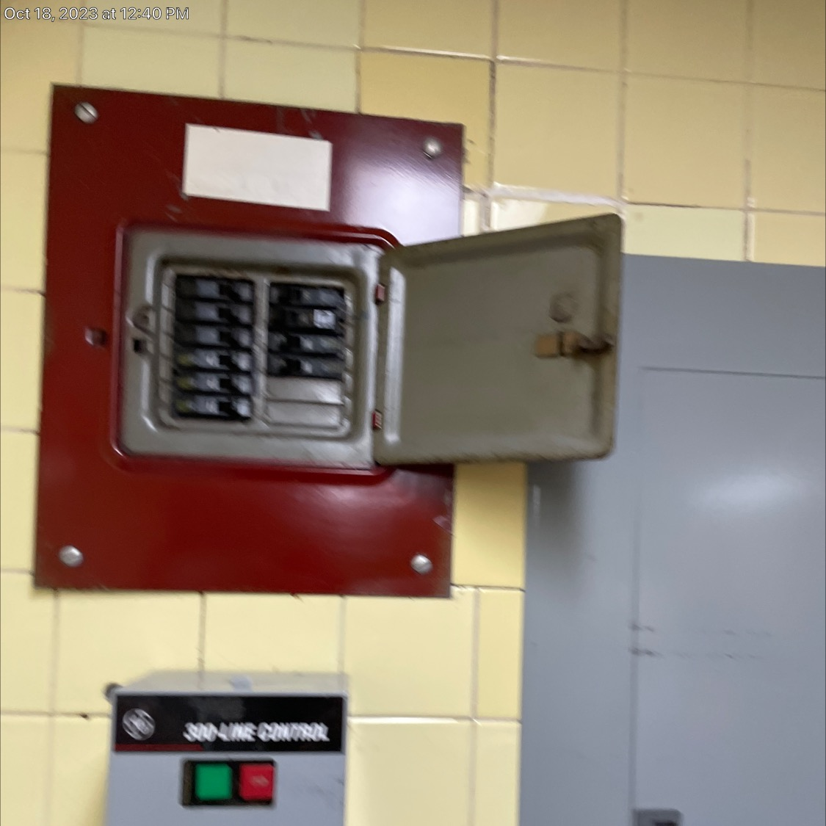
HEALTH CARE FACILITIES
CODE REQUIREMENTS
Be sure to have all documentation on hand
items typically missed are :
Annual fuel testing
Three Year load test
Annual load bank if required do to loading.
Emergency battery lights in areas of the transfer switches and generator
The separation of Life Safety and Critical Systems in the emergency distribution power.
Time clocks are not critical as far as this goes although telephones are.
K915-K918 Electrical Systems – Essential Electric System Categories
Missing proper documentation for the testing and maintenance of the emergency power distribution and generator.
Having the wrong type of EES for your resident care level minimum is type II, for life support requires a type III.
The different type require different separations of loads applied.
Testing and inspection of the transfer switches.

Slide 15
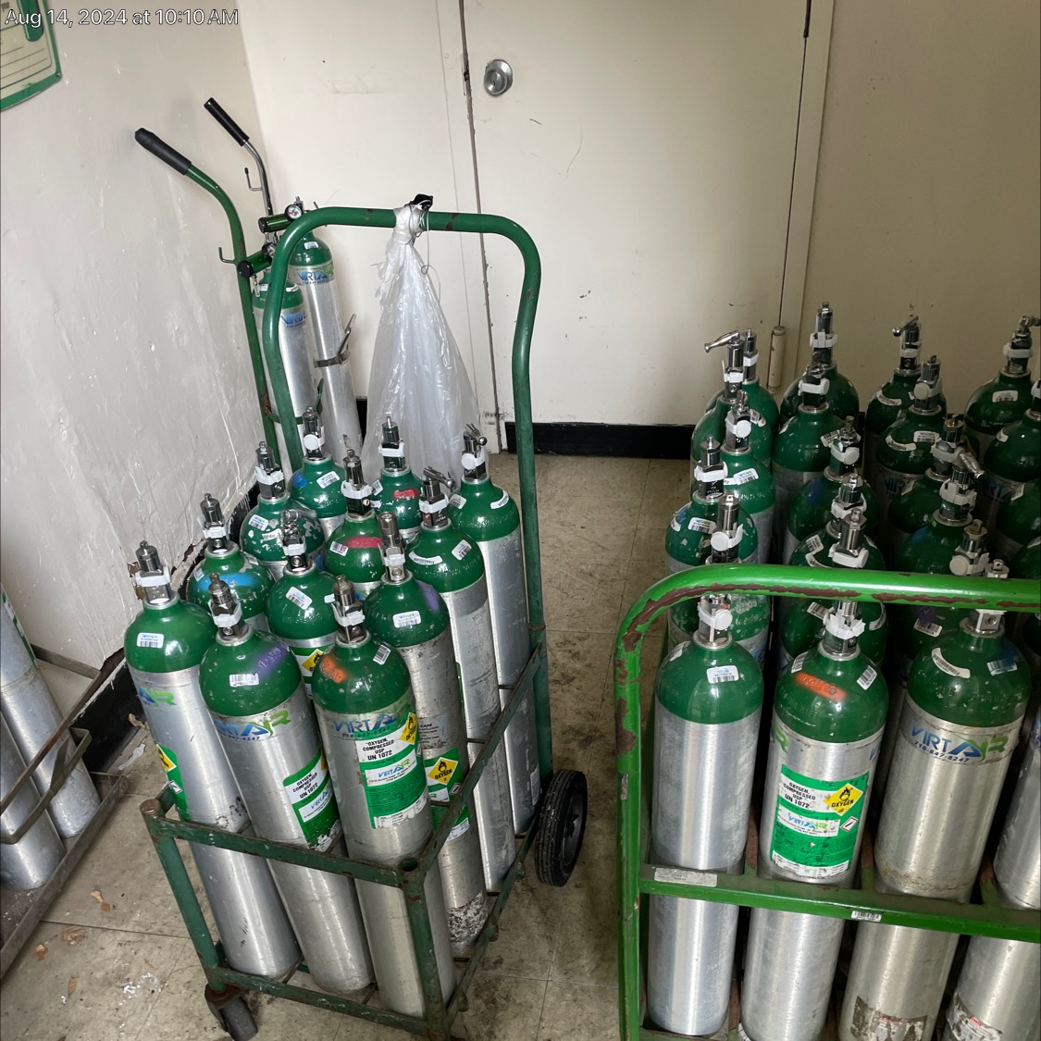
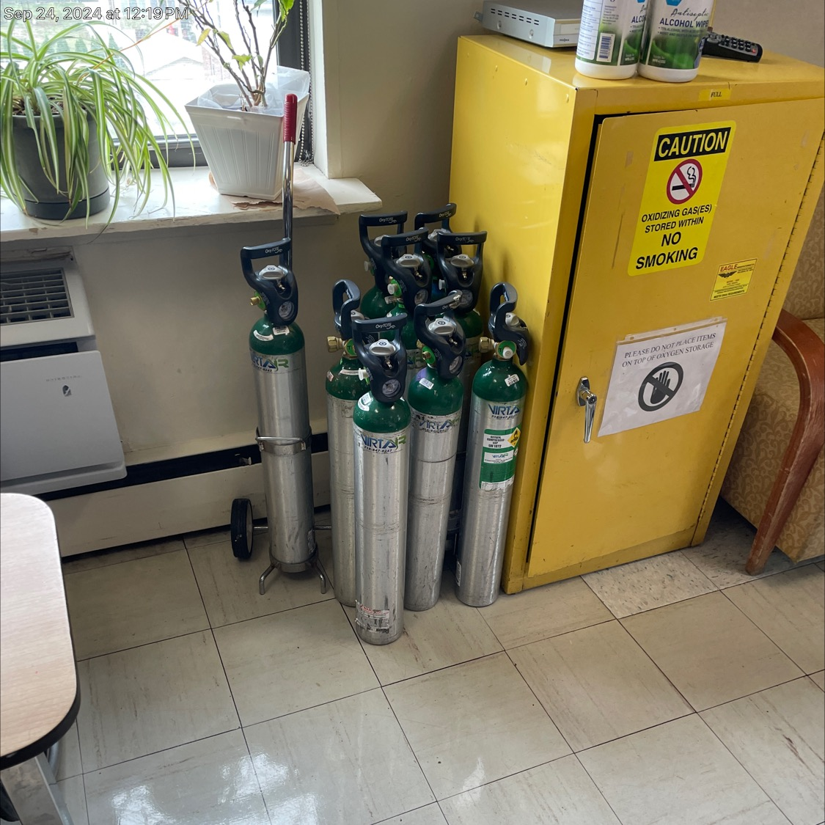
Low Hanging Fruit K921 K923
K921 PCREE Patient Care Electric Equipment
The required electrical inspections are completed .
There needs to be manuals for all the equipment readily available.
Maintenance is not just the annual test but in accordance with manufacturer.
K 923 Oxygen storage and use.
Appropriate for the area size and cubic feet stored are related.
Proper ventilation and electric.

Slide 16

Thank you
Questions ?
John F Kerney
JFK Safety Consultants
GNYHCFA
Ridgefieldjfk@aol.com

